Slide 1
Application of energy storage in systems with large penetration of intermittent renewables
Lucas Narbondo

Slide 2
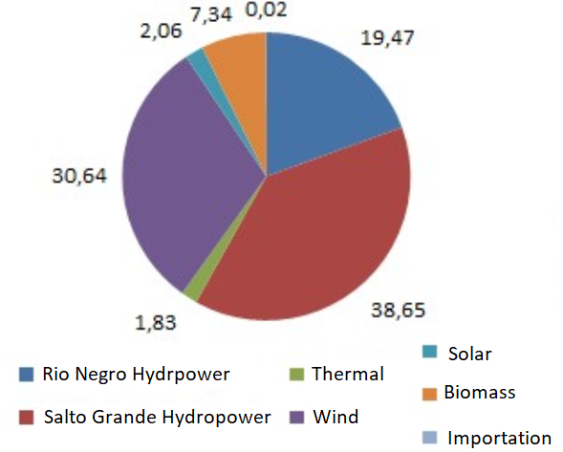
MOTIVATIONS
Ten years ago, Uruguayan generation was composed by 1450MW of hydropower (65% of installed capacity), 700MW of Thermal Power (32%) and 70MW of energy generated from biomass (3%).
The country implemented policies to favour the incorporation of non-conventional renewable energy and today clean generation provides almost 95% of the electricity consumption, as seen in the Figure below.

Slide 3
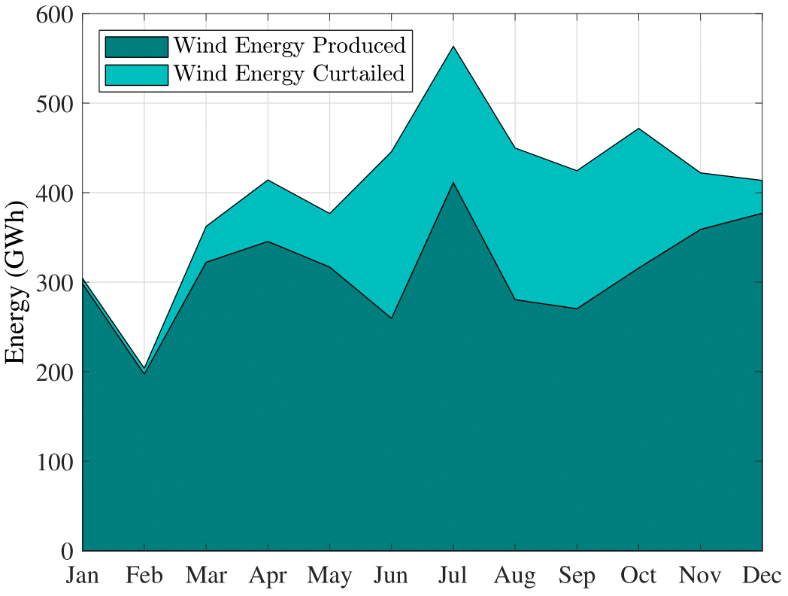
However, Uruguay has installed so much renewable energy that wind curtailment levels reach as high as 22% in 2017.
Therefore, the flexibility that energy storage technologies provide is of huge interest for taking advantage of the energy that is otherwise wasted.
A private investment perspective was analysed, where energy arbitrage was done in the wholesale market. On a later stage, revenue from providing an Enhanced Frequency Response service was introduced.
Government perspective to study if the incorporation of batteries reduces the thermal production enough to make them feasible.

Slide 4

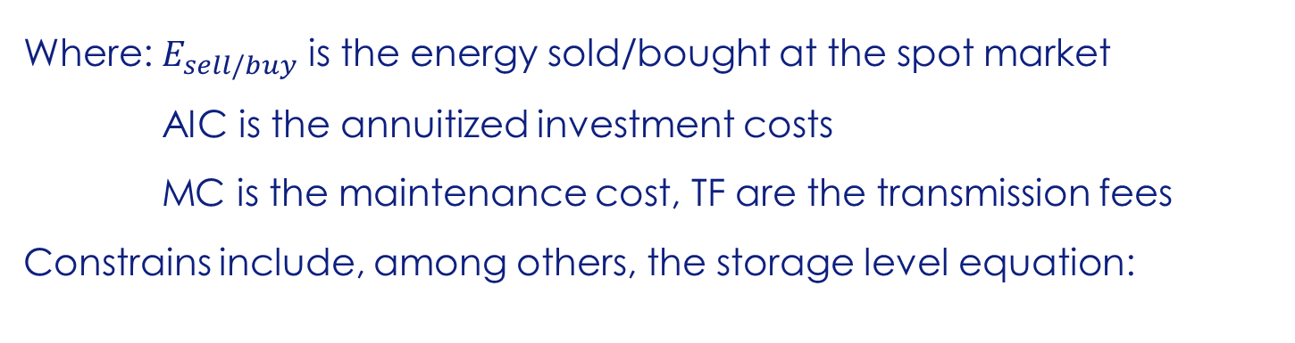
METHODS:
We solve the optimization problem:
Where: $E_{sell/buy}$ is the energy sold/bought at the spot market
AIC is the annuitized investment costs
MC is the maintenance cost, TF are the transmission fees
Constrains include, among others, the storage level equation:
Private investor perspective

Slide 5


For the Enhanced Frequency Response we introduce a revenue for
providing the service and bound the charging limits of the battery to be
able to supply the necessary energy.
Because of time constrains, the problem was kept simple.
We do not consider conflicts in providing the service and doing arbitrage.
We only allow the battery to do arbitrage within the bounded limits.
Enhanced Frequency response

Slide 6
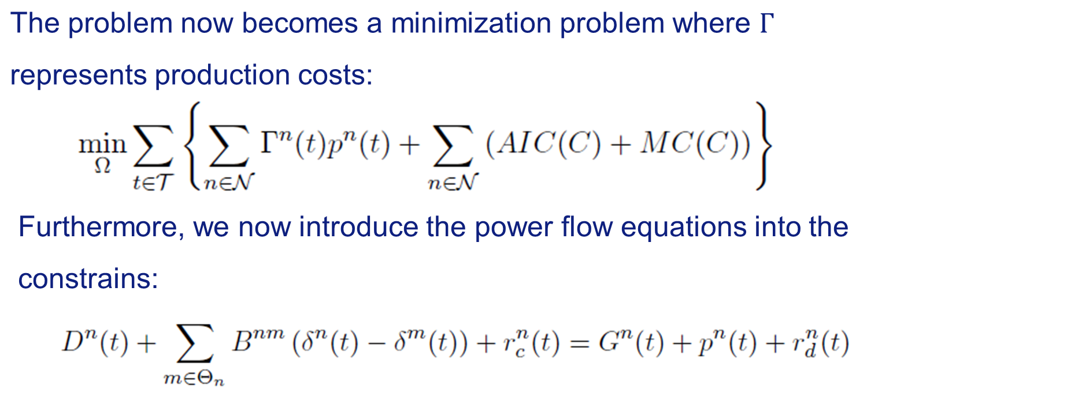
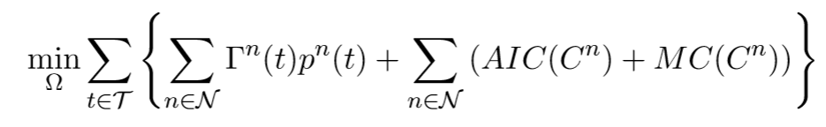
METHODS:
Government perspective

Slide 7
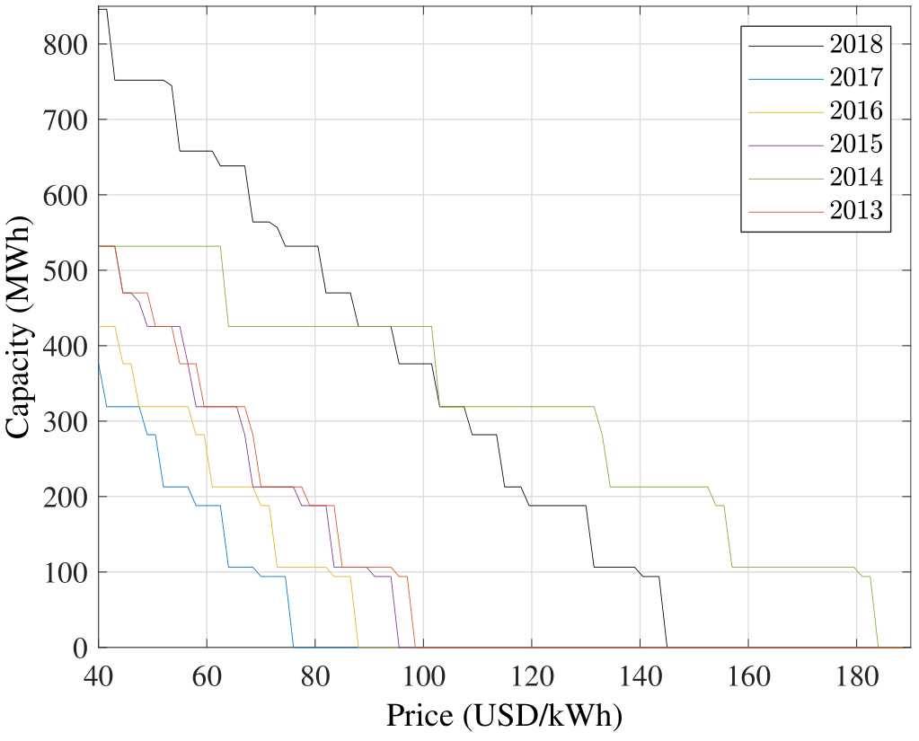
RESULTS:
The Figure shows the optimal capacity to be installed as a function of the battery price when fixing the battery charge/discharge rate to 100MW,
We can observe that rainy years (2017, 2016, 2015, 2013) are not very attractive because of a low spot price.
Private investment

Slide 8
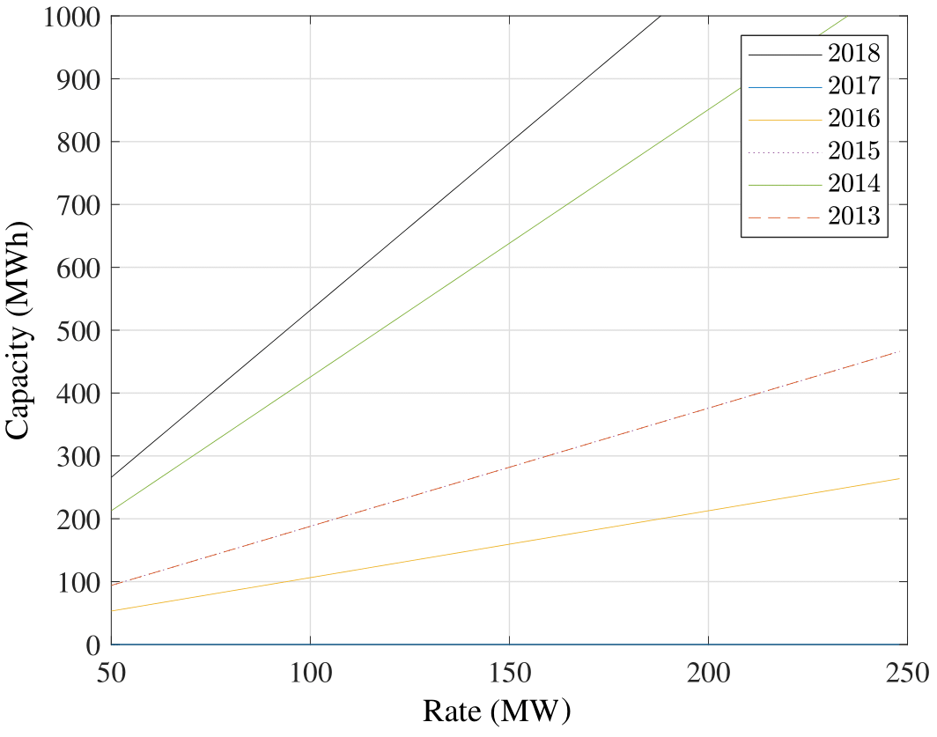
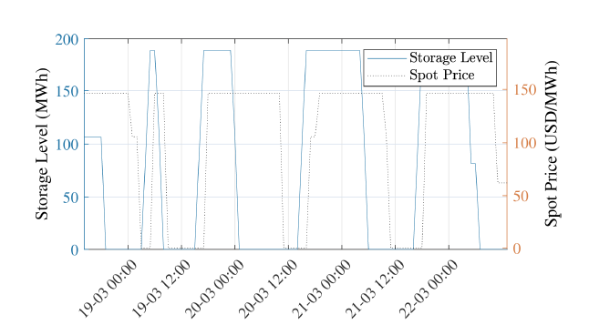
On the other hand, we can observe the capacity as a function of the rate when fixing the price.
Also, the behavior of the battery charge/discharge with the spot price, where it can be appreciated how the battery charges when the spot is low and discharges when high

Slide 9
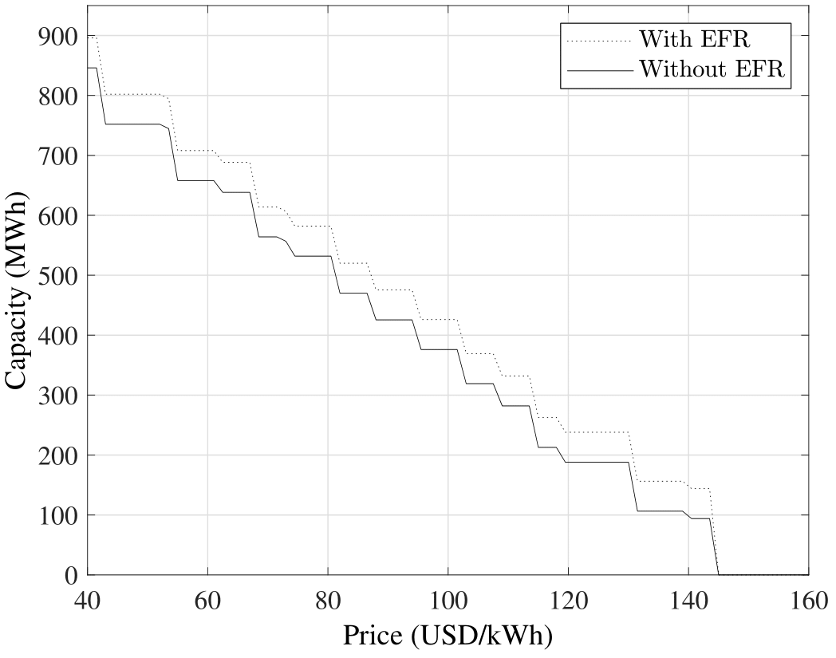
RESULTS:
A slight increase in the amount of optimal capacity to install can be observed in every scenario (2018 in Figure).
Furthermore, the revenue greatly increases making it much more attractive to invest in batteries if the EFR revenue is considered. However, we still observe the dependence with the rainfall regime, where wet years still need extremely low prices to make it profitable.
Enhanced Frequency Response

Slide 10
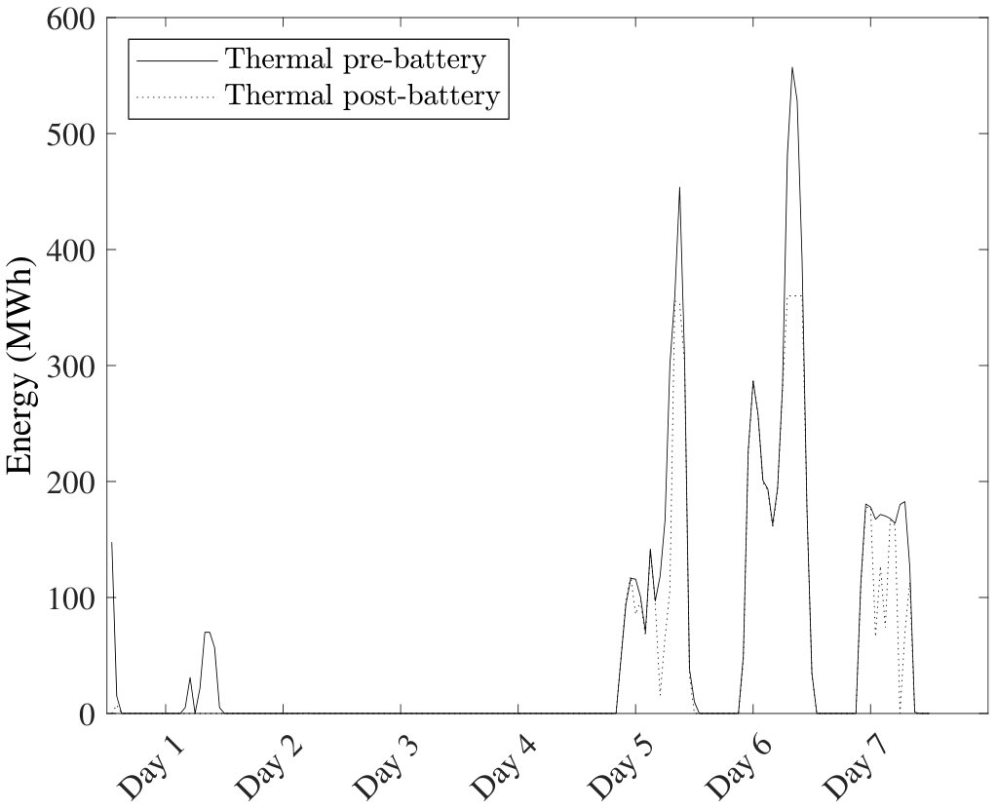
RESULTS:
Four scenarios were analysed; dry scenarios with inexistent hydro curtailment and wet scenarios with considerable hydro curtailment.
For wet scenarios, the optimal capacity to install was 500MWh and 700MWh
For dry scenarios the optimal capacity was 0 and 100MWh.
For those three scenarios, the savings per week are approximately 6,000 USD/MWh.
Government perspective

Slide 11
CONCLUSIONS
From a private investor perspective, regulations in batteries are not suitable for investing in batteries given that transmission fees are very high.
Even without transmission fees, current battery prices make arbitrage not profitable.
The EFR service improves considerably the perspective for private investors. However, frequency regulation is done by Argentina, so currently it is not of interest for the Uruguayan government to pay for this service.
From the government perspective, both wet and dry scenarios provide enough revenue to pay back the investment in 4-5 years.

Slide 12
future works
Future works using the Uruguayan software SimSEE would be of interest (software used for optimal dispatch), incorporating stochastic variables and solve the problem with a long-term vision instead of using past data, analyzing the optimal expansion of the system.
Finally, include batteries into transmission/distribution planning to reduce and/or replace investment in these areas.

